Slide 1
Loan Approval Prediction
Presented by: Nayak Karan Govardhan
Gujar Sanika Chandrakant
Class: MCA 2nd Year (Sem-III)
Project Title: Loan Approval Prediction
Guide Name: Prof. Pradnya Baviskar

Slide 2
Introduction of Project
Loan approval is an important process in banks and financial institutions
Banks need to decide whether a loan should be approved or rejected
This project is called Loan Approval Prediction
It uses Machine Learning to predict loan approval status
Prediction is based on applicant income, credit history, loan amount, employment status, and property area
The system is developed using Python
A simple Tkinter GUI is provided for easy use
This project helps banks make fast, accurate, and risk-free loan approval decisions

Slide 3
Objectives
To develop a Tkinter-based interface for easy use
To assist banks in making loan approval decisions
To predict whether a loan application should be approved or rejected
To use machine learning techniques for accurate loan prediction
To analyze applicant features such as income, credit history, loan amount, and employment details
To reduce financial risk by identifying high-risk applicants
To provide a simple and user-friendly interface for loan officers

Slide 4
Modules
1. Data Collection Module –
Handles importing and loading of loan application dataset
Verifies data format, consistency, and data quality
2. Data Preprocessing Module –
Cleans the dataset by handling missing values
Encodes categorical variables and normalizes numerical data
Removes null, duplicate, or invalid entries
3. Prediction Module –
Takes user input via GUI (income, credit history, loan amount, etc.)
Loads the trained machine learning model
Predicts loan status as Approved / Not Approved
4. GUI (Frontend) Module –
Developed using Tkinter
Provides input fields for applicant details
Includes buttons for “Predict”, “Reset”, and “Exit”

Slide 5
System design
Tools & Technology used in Loan Approval Prediction :
Programming Language: Python
Machine Learning Library: Scikit-learn, XGBoost
Data Handling: Pandas, NumPy
GUI Tool: Tkinter
Development Tools: VS Code / Jupyter Notebook / PyCharm
Operating System: Windows

Slide 6
Algorithm
Random Forest is a machine learning classification algorithm
It builds multiple decision trees from the loan dataset
Each tree independently predicts loan approval status
The final output is based on majority voting of all trees
It works well with large, complex, and non-linear data

Slide 7
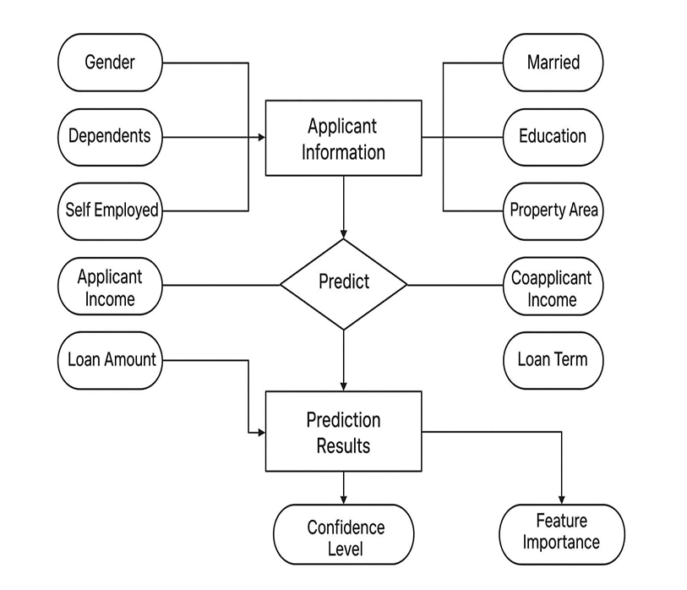
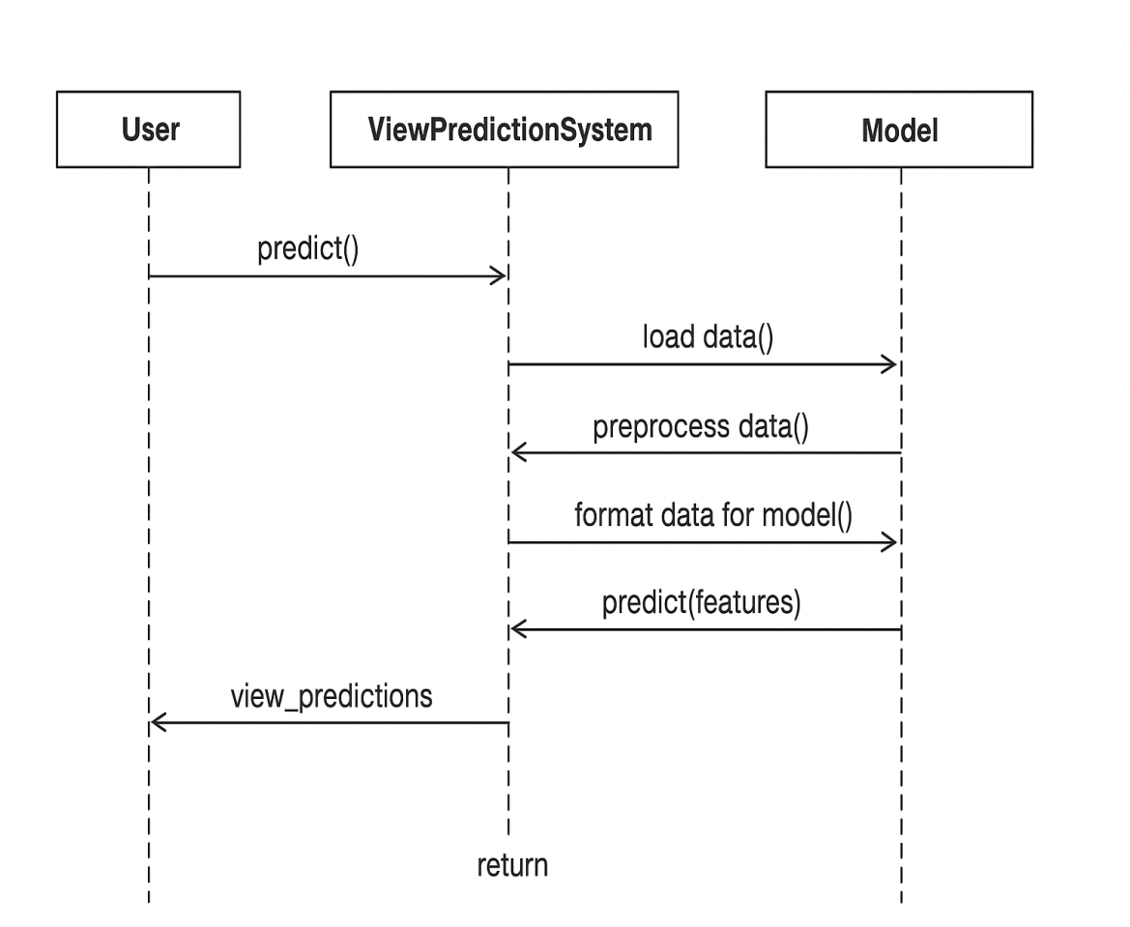
Preliminary design
(Diagrams)

Slide 8
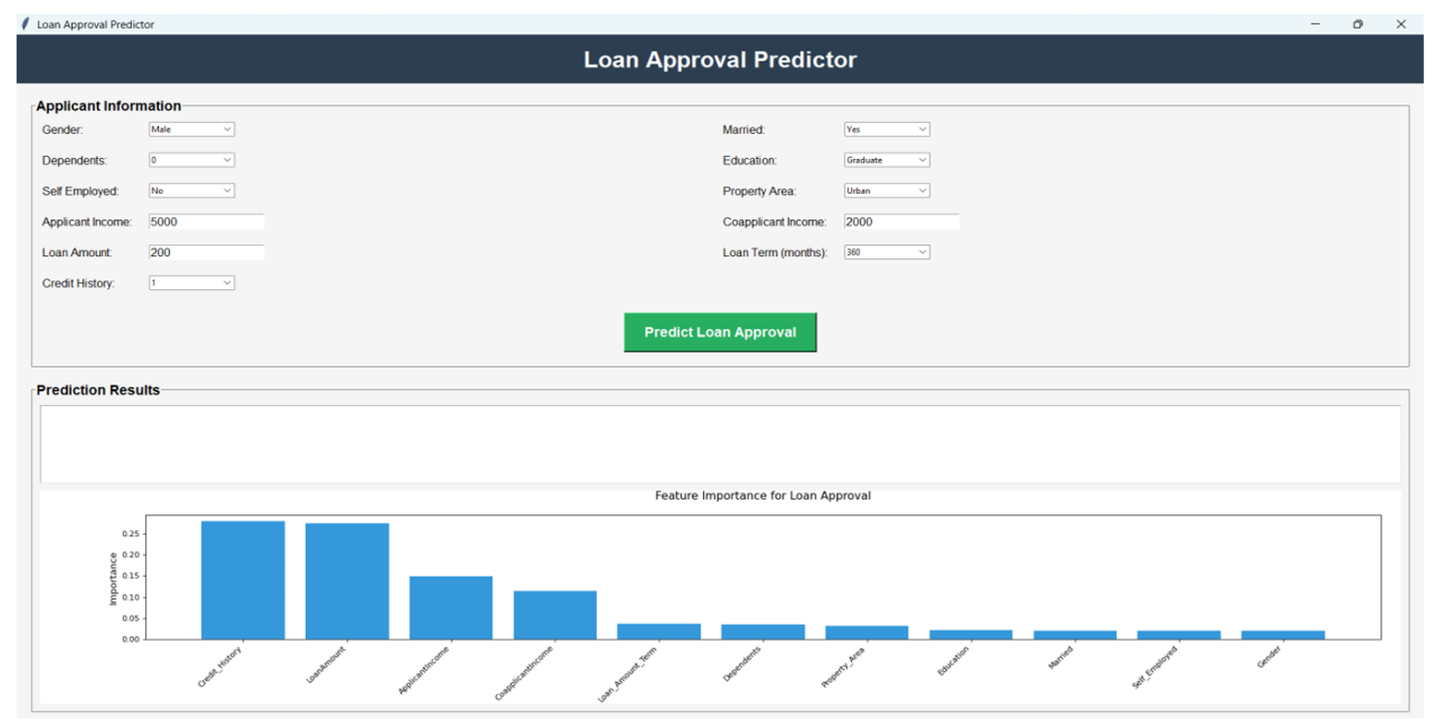
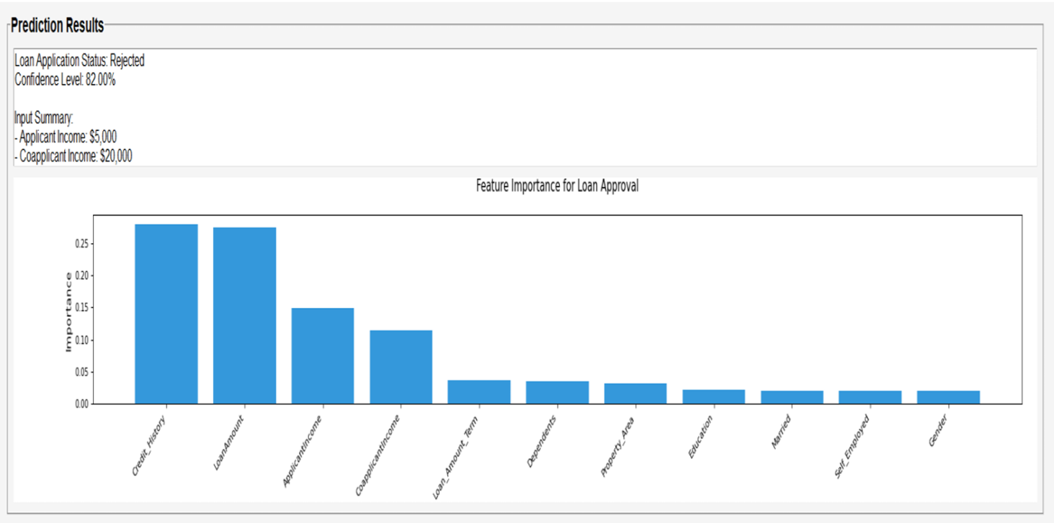
Output screenshots

Slide 9
Strength
Provides accurate prediction of loan approval status
Easy to use and user-friendly interface
Low cost and uses open-source tools
Uses machine learning for better decision-making
Helps banks evaluate loan applications efficiently
Saves time and effort for loan officers and institutions

Slide 10
Limitations
Predictions depend on the quality of loan dataset
Accuracy may reduce with limited or outdated data
Cannot guarantee 100% accurate loan approval decisions
Desktop-based application only (if GUI based)
External economic or policy factors cannot be predicted

Slide 11
Future scope
1. Web-Based or Cloud Deployment:
The project can be upgraded from a desktop application to a web-based or cloud-based system for easier access, scalability, and real-time processing.
2. More Predictive Features:
Future versions can include additional parameters such as employment history, transaction patterns, credit bureau scores, and debt-to-income ratio to improve prediction accuracy.
3. Real-Time Analytics Dashboard:
Live charts and visualizations can be added to analyze loan approval trends, risk levels, and applicant behavior dynamically.
4. Mobile Application Development:
The system can be developed as a mobile application to allow bank officials to access and evaluate loan applications anytime and anywhere.

Slide 12
Conclusion
The project successfully predicts loan approval status using machine learning.
It analyzes important applicant features such as income, credit history, loan amount, and employment details.
The system is easy to use and user-friendly.
It helps banks and loan officers make better and faster decisions before approving loans.
The project demonstrates the practical application of machine learning in the banking and financial sector.

Slide 13
Reference
https://dl.acm.org/doi/10.1145/1298306.1298311
https://dl.acm.org/doi/10.1145/1935826.1935878
https://dl.acm.org/doi/10.1145/2433396.2433440
https://dl.acm.org/doi/10.1145/2187836.2187840
https://thesai.org/Publications/ViewPaper
https://ojs.aaai.org/index.php/ICWSM/article/view/14706

Slide 14
Thank You….

